Slide 1
Pentecost

Slide 2
Who are you?

Slide 3
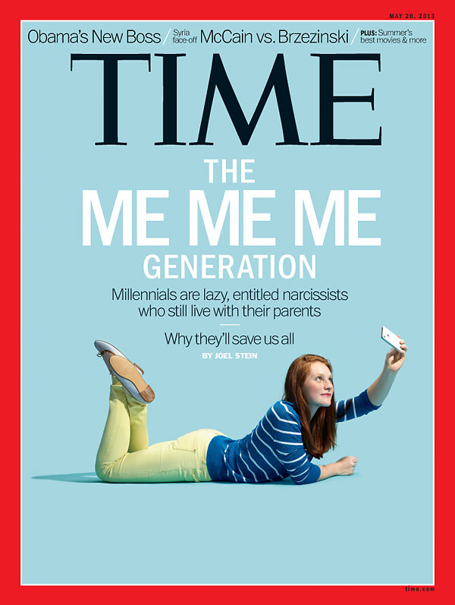

Slide 4
nar·cis·sism
Noun
Excessive interest in oneself and one's physical appearance. Extreme selfishness, with a grandiose view of one's own talents and a craving for admiration.

Slide 5
"When they're little it seems cute to tell them they're special or a princess or a rock star or whatever their T-shirt says. When they're 14 it's no longer cute.“ All that self-esteem leads them to be disappointed when the world refuses to affirm how great they know they are.
http://www.time.com/time/subscriber/article/0,33009,2143001-2,00.html

Slide 6
It’s not about you.

Slide 7
Who are you?

Slide 8
Who Am I in Christ?
I am accepted...
John 1:12 I am God's child.
John 15:15 As a disciple, I am a friend of Jesus Christ.
Romans 5:1 I have been justified.
1 Corinthians 6:17 I am united with the Lord, and I am one with Him in spirit.
1 Corinthians 6:19-20 I have been bought with a price and I belong to God.

Slide 9
1 Corinthians 12:27 I am a member of Christ's body.
Ephesians 1:3-8 I have been chosen by God and adopted as His child.
Colossians 1:13-14 I have been redeemed and forgiven of all my sins.
Colossians 2:9-10 I am complete in Christ.
Hebrews 4:14-16 I have direct access to the throne of grace through Jesus Christ.

Slide 10
I am secure...
Romans 8:1-2 I am free from condemnation.
Romans 8:28 I am assured that God works for my good in all circumstances.
Romans 8:31-39 I am free from any condemnation brought against me and I cannot be separated from the love of
God.
2 Corinthians 1:21-22 I have been established, anointed and sealed by God.

Slide 11
Colossians 3:1-4 I am hidden with Christ in God.
Philippians 1:6 I am confident that God will complete the good work He started in me.
Philippians 3:20 I am a citizen of heaven.
2 Timothy 1:7 I have not been given a spirit of fear but of power, love and a sound mind.
1 John 5:18 I am born of God and the evil one cannot touch me.

Slide 12
I am significant...
John 15:5 I am a branch of Jesus Christ, the true vine, and a channel of His life.
John 15:16 I have been chosen and appointed to bear fruit.
1 Corinthians 3:16 I am God's temple.
2 Corinthians 5:17-21 I am a minister of reconciliation for God.

Slide 13
Ephesians 2:6 I am seated with Jesus Christ in the heavenly realm.
Ephesians 2:10 I am God's workmanship.
Ephesians 3:12 I may approach God with freedom and confidence.
Philippians 4:13 I can do all things through Christ, who strengthens me.
<http://www.ficm.org/index.php?command=textwhoamiinchrist>

