Slide 1
Cup Stacking

Slide 2
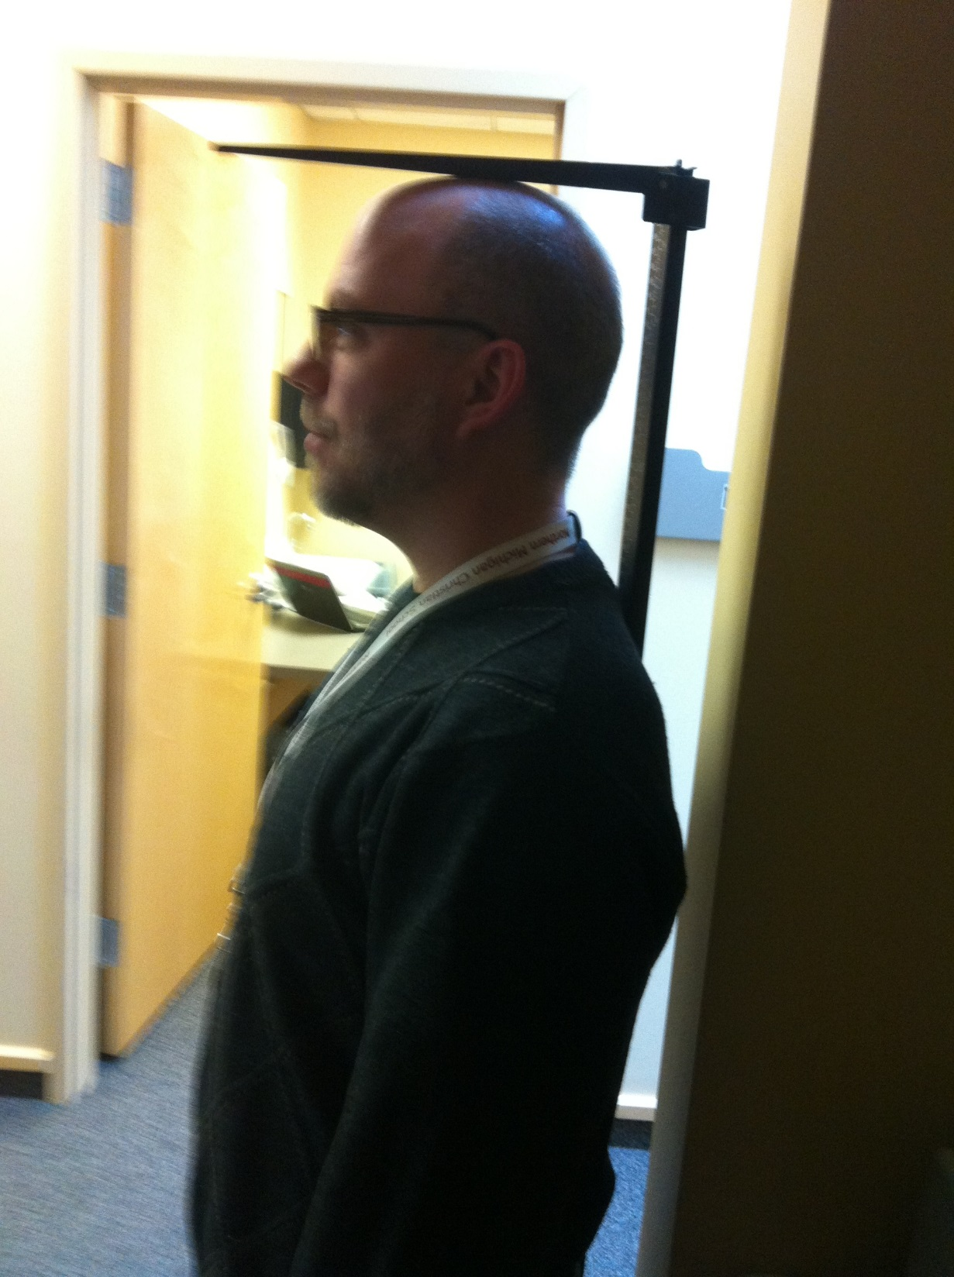

Slide 3
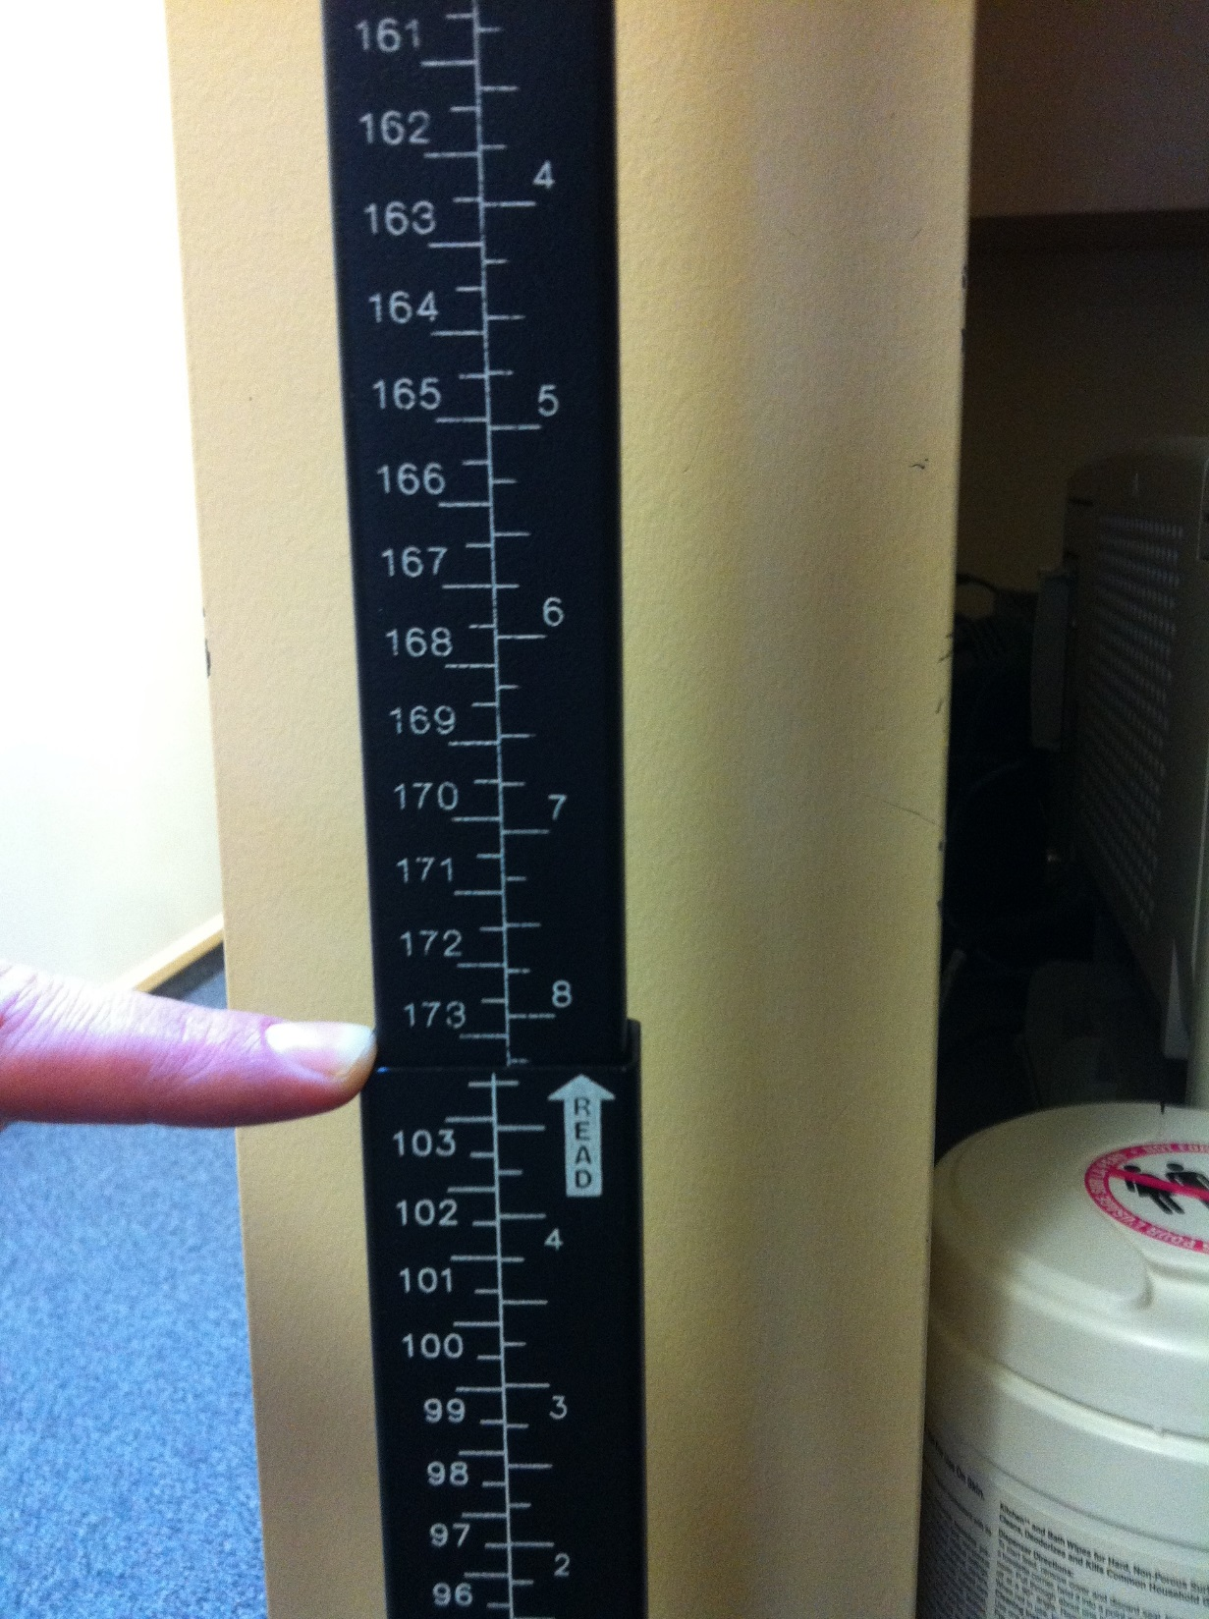

Slide 4
Estimate how many cups you would need to stack to reach my height.

Slide 5
Exactly how many cups would you need to stack to reach my height?

Slide 7
9.1
cm

Slide 9
1.3 cm

