Slide 1
Math and the Environment
Applications of Exponents

Slide 2
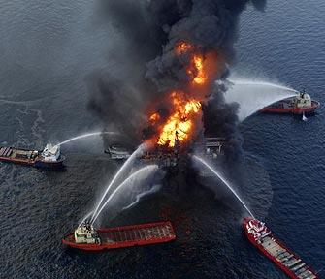
2010 BP Deep Water Horizon
Largest US Oil Spill
Gulf of Mexico
-11 Dead
-206 Million Gallons

Slide 3
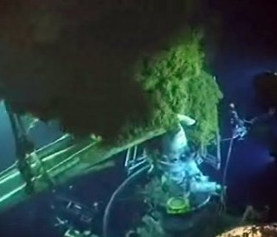
2010 BP Deep Water Horizon
The well released oil for 87 days.
42 miles of the coast of Louisiana.

Slide 4
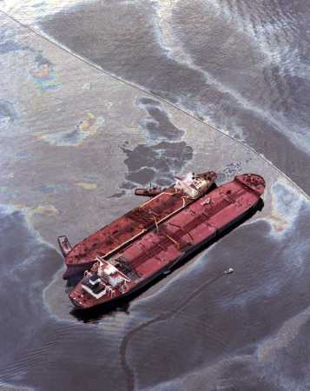
1989 Exxon Valdez
Most Environmentally Devastating Oil Spill
Prince William Sound - Alaska
11 Million Gallons

Slide 5
Rank | Date | Cause | Source | Location | Spill Volume
1. | April 20, 2010 | explosion | drilling rig Deepwater Horizon | Gulf of Mexico, 50 miles off the coast of Louisiana | an estimated 200,000 gallons a day
2. | March 24, 1989 | reef collision | tanker Exxon Valdez | Prince William Sound, Alaska | 10+ million gallons
3. | Dec. 15, 1976 | ran aground | tanker Argo Merchant | Nantucket Island | 7.7 million gallons
4. | Aug.–Sept. 2005 | Hurricane Katrina | various sources | New Orleans, La. | 7 million gallons
5. | June 8, 1990 | explosion | tanker Mega Borg | 60 miles off Galveston, Texas | 5.1 million gallons
6. | Nov. 28, 2000 | ran aground | tanker Westchester | Port Sulphur, La. | 567,000 gallons
7. | Jan. 23, 2010 | collision | tanker Eagle Otome | Port Arthur, Texas | 462,000 gallons
8. | July 25, 2008 | collision | unnamed barge | New Orleans, La. | 419,000 gallons
9. | Dec. 7, 2004 | ran aground | M/V Selendang Ayu | Aleutian Islands, Alaska | 337,000 gallons
10. | Aug. 10, 1993 | collision | barge Bouchard B155 | Tampa Bay, Fla. | 336,000 gallons
Read more: Ten Largest Offshore Oil Spills in the U.S. | Infoplease.com http://www.infoplease.com/science/environment/largest-oil-spills-united-states.html#ixzz3IJzrxuU0

Slide 6
How can we predict how long it will take to clean up the pollution?

Slide 7
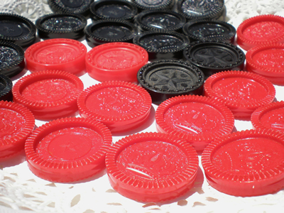
Simulation:

Slide 8
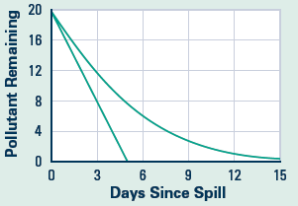
Which Option?

Slide 9
Exxon Valdez Data to Consider:
An Estimated 11 million gallons of oil spilled into the Price William Sound in 1989.
25 years later, there are between 16 and 21 thousand gallons of oil still in the environment. (http://www.pbs.org/newshour/updates/25-years-later-scientists-remember-exxon-valdez-spill/#the-rundown)

Slide 10
BP Deepwater Horizon
There isn’t any current data on the amount of oil left over from the oil spill in the Gulf of Mexico.
If we assume a similar rate of change to that of the Exxon Valdez, how would we model the situation?

